Slide 1


Electron Cloud Effects: Heat Load and Stability Issues
G. Iadarola, A. Axford, K. Li, A. Romano, G. Rumolo
Acknowledgments:
H.Bartosik, R. De Maria, C. Garion, A. Oeftiger, M. Schenk, R. Tomas
Joint HiLumi LHC - LARP Annual Meeting, 11-13 November 2015, Fermilab, USA

Slide 2
e-cloud in the LHC: where do we stand
Run 1 experience has shown that electron cloud effects can limit the achievable performance with 25 ns beams mainly through beam degradation at low energy and high heat load at high energy
Two scrubbing runs scheduled for 2015 (>20 days in total starting in June) to lower SEY of the beam chamber and allow 25 ns physics
Special scrubbing beam (“doublet”) in preparation in the injectors
Important experience in order to quantify how effectively scrubbing can mitigate e-cloud effects → important input for HL-LHC

Slide 3
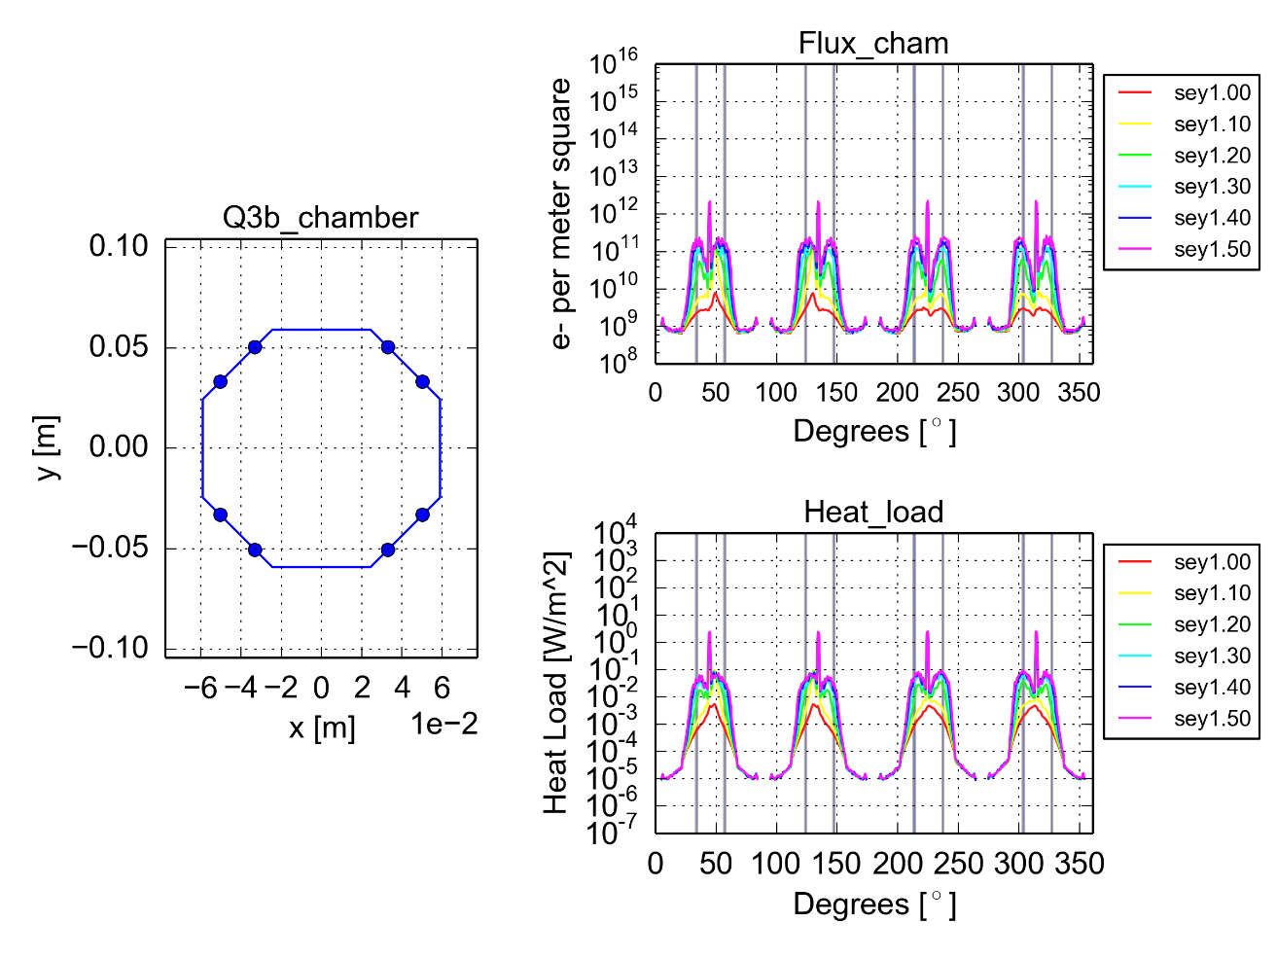

Buildup simulations for the HL-LHC
Impact of HL-LHC beam parameters estimated by PyECLOUD simulation for several machine components (mainly cold magnets)
Multipacting threshold and heat load estimated for:
Arc main magnets
Matching quadrupoles (present and HL-LHC design)
Separation/recombination dipoles(present and HL-LHC design)
Inner triplets (present and HL-LHC design)
Ongoing development to study the impact of shields at the pumping holes (baffles)
Details can be found in:
G. Iadarola et al., “Beam induced heat load in the cold elements of the IRs”, at LARP-HiLumi Meeting, 20 November 2015, KEK – Japan
G. Rumolo et al., “Progress on electron cloud studies for HL-LHC”, at 48th HiLumi WP2 Task Leader Meeting, 24 April 2015, CERN

Slide 4
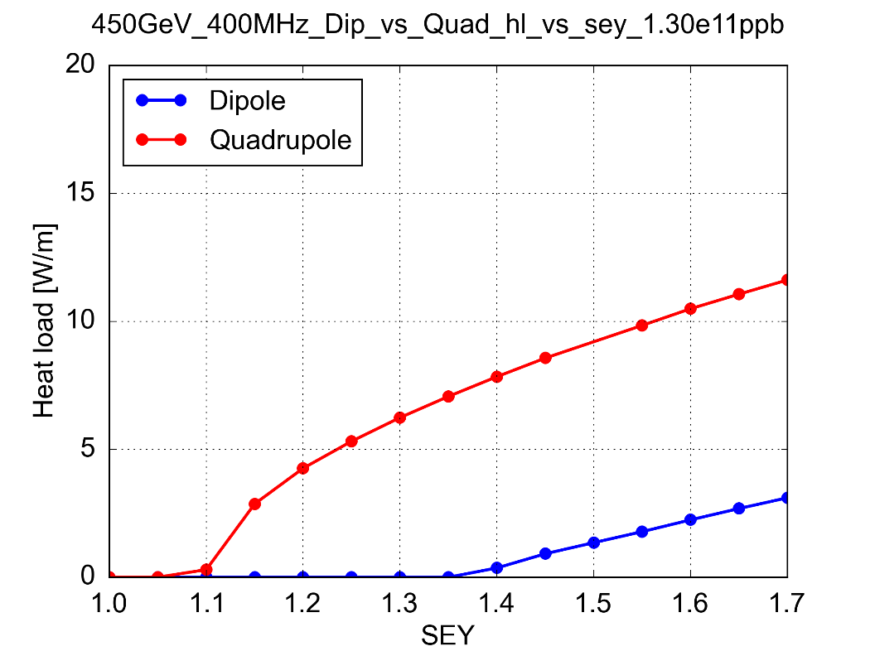
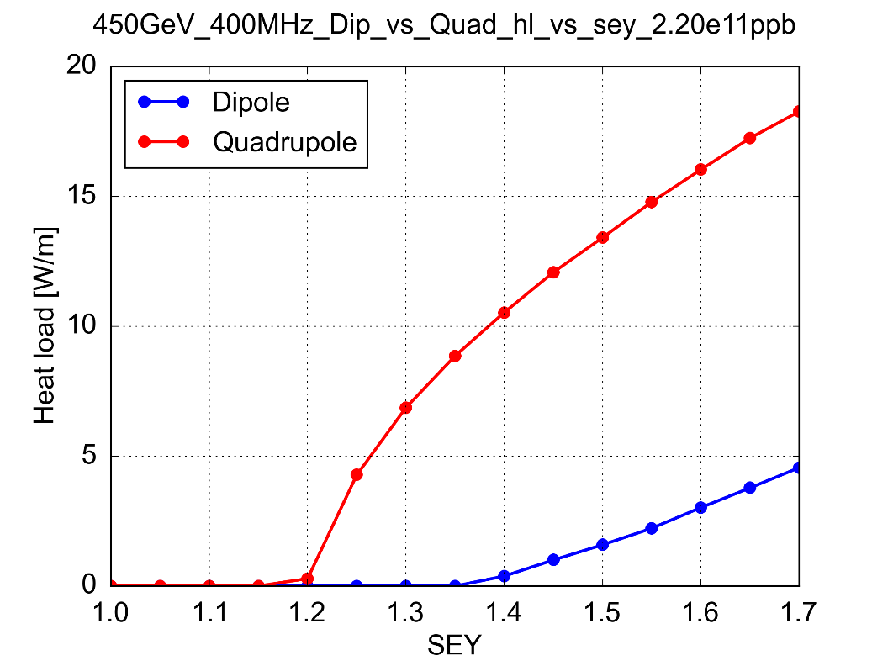
e-cloud in the arc main magnets
For cold magnets in the arcs we will have to rely on beam induced scrubbing also in the HL-LHC era
Nominal
HL-LHC
Stronger heat load in the HL-LHC mainly for large values of SEY
Scrubbing should allow us to achieve SEY<1.3 → e-cloud suppression in the dipoles
Heat load in the arcs within cryo cooling capacity
But e-cloud still present in the quadrupoles
What is the effect on beam stability/degradation?

Slide 5
The PyECLOUD-PyHEADTAIL simulation setup
Impact of e-cloud on beam quality/stability is usually estimated by MacroParticle (MP) simulations
Unfortunately the available tool (HEADTAIL) could not handle the required simulation scenarios (quadrupole field, non negligible impact of the beam chamber)
→ Important code development activity the last year in the framework of a much broader reorganization of our simulation tools:
Monolithic code
HEADTAIL
Modular and scriptable tool
PyHEADTAIL
See also: K. Li, “PyHEADTAIL”, at BE-ABP information meeting, 12 March 2015, CERN

Slide 6
The PyECLOUD-PyHEADTAIL simulation setup
We dropped the traditional approach of having separate tools for ecloud buildup and instability
Use PyECLOUD also simulate the interaction beam/ecloud within PyHEADTAIL
→ Possible thanks to the highly modular structure of the two codes (object oriented)
PyHEADTAIL
PyECLOUD
(PyEC4PyHT object)
PyHEADTAIL
v
Initial e- distribution
(from PyECLOUD buildup sim.)
For each slice
Transverse tracking
→ with Q’, octupoles etc.
Longitudinal tracking
Transverse feedback
Impedances
Space charge
…
Generate seed e⁻
PyHEADTAIL bunch
PyHEADTAIL slicer
Evaluate beam slice electric field (Particle in Cell)
Evaluate the e⁻ electric field
(Particle in Cell)
Transverse tracking
→ with Q’, octupoles etc.
Longitudinal tracking
Transverse feedback
Impedances
Space charge
…
Apply kick on the beam particles
PyHEADTAIL bunch
Compute e⁻ motion (t->t+Δt)
(possibly with substeps)
Detect impacts and generate secondaries
Legend: From PyHEADTAIL From PyECLOUD Developed ad hoc

Slide 7
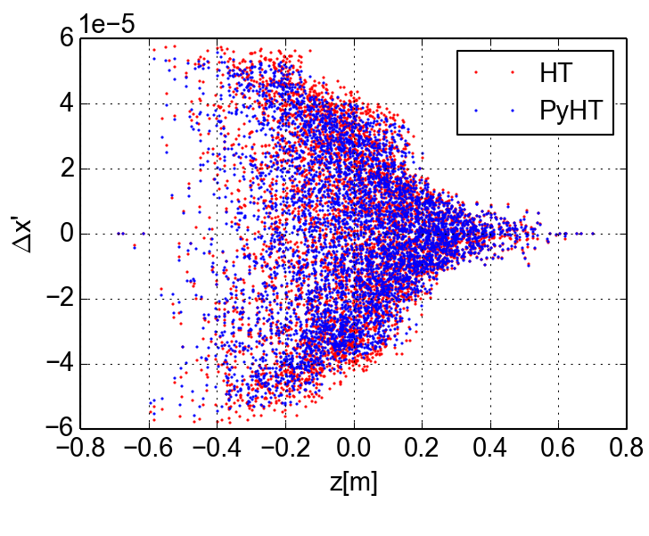
The PyECLOUD-PyHEADTAIL simulation setup
We dropped the traditional approach of having separate tools for ecloud buildup and instability
Use PyECLOUD also simulate the interaction beam/ecloud within PyHEADTAIL
→ Possible thanks to the highly modular structure of the two codes (object oriented)
Advantages of this approach:
Profits from years of optimization and testing work on PyECLOUD and PyHEADTAIL
All advanced e-cloud modeling features implemented in PyECLOUD become naturally available for beam dynamics simulations
From now on the two tools can share most of the work of development and maintenance
Extensive tests against HEADTAIL in the last year:
Single e-cloud interaction
Single turn
Tune footprint
E-cloud instabilities
Since ~2 months the new code is being used for instabilities simulation campaigns for LIU-SPS and HL-LHC studies (though with simplified model at this stage, i.e. uniform beta function, uniform initial e⁻ distribution)

Slide 8
e-cloud instability simulations for the HL-LHC
We simulated the interaction of a single bunch with the electron cloud in the dipoles and in the quadrupoles separately scanning the bunch intensity and the electron density
Before the bunch passage electrons are uniformly distributed and at rest in the chamber
Parameter | Value @ 450 GeV | Value @ 7 TeV
N (p/b) | 1.3 – 2.3 x 10¹¹ | 1.3 – 2.3 x 10¹¹
ε_{x,y} (μm) | 2.5 | 2.5
σ_{z} (m) | 0.1 | 0. 075
B (T, T/m) | 0.53, 12 | 8.2, 187
V_{400MHz} (MV) | 8 | 16
N_{el} (e⁻/m³) | 0.3 – 20 x 10¹² | 0.3 – 20 x 10¹³
N_{segments} | 79 | 31
N_{MP} (e⁻) | 10⁵ | 10⁵
N_{MP} (p) | 3 x 10⁵ | 3 x 10⁵
N_{slices} (-2σ_{z}, 2σ_{z}) | 64 | 64
Q_{x}, Q_{y} | 62.28 | 60.31
<β_{x}>, <β_{y}> | 92.7 | 93.2

Slide 9
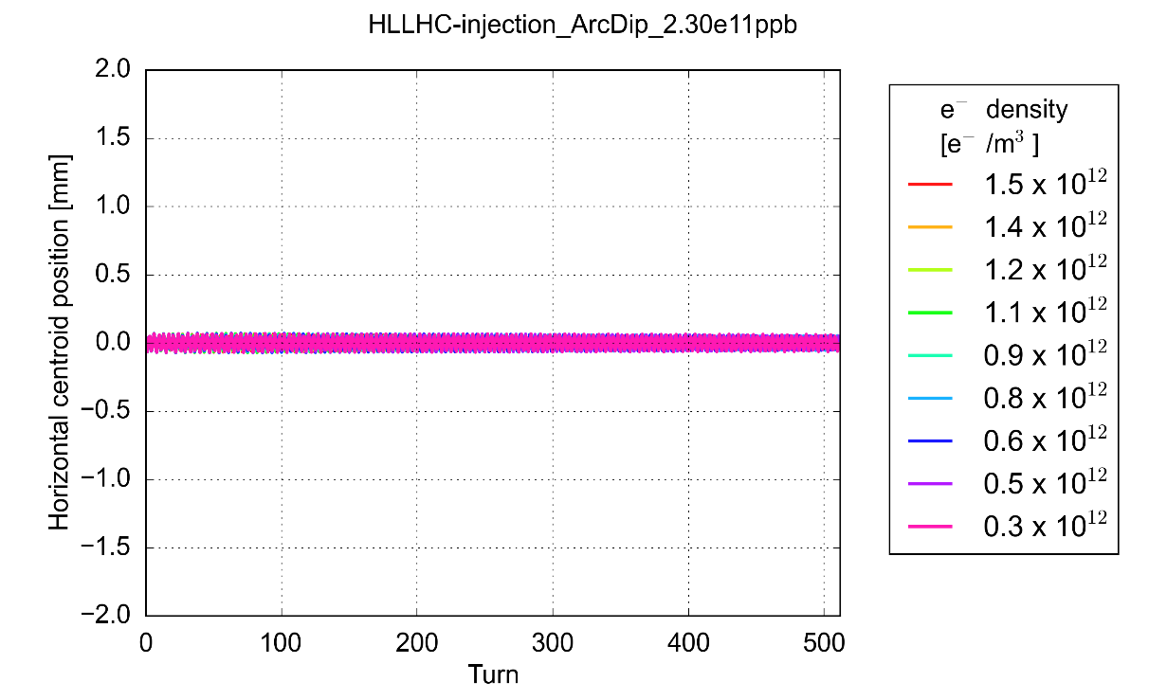
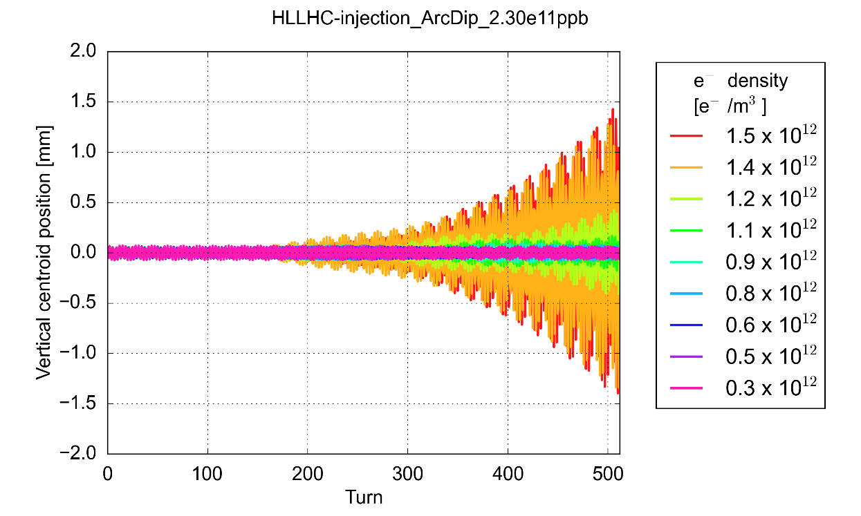
e-cloud instability thresholds: Arc Dipoles
Arc dipoles (~65% of the machine)
N = 2.3 x 10¹¹ p/b
Instability observed only in the vertical plane, as the dipole magnetic field freezes the electron motion in the horizontal plane (note that, unlike HEADTAIL, electrons are tracked also in the horizontal plane)

Slide 10
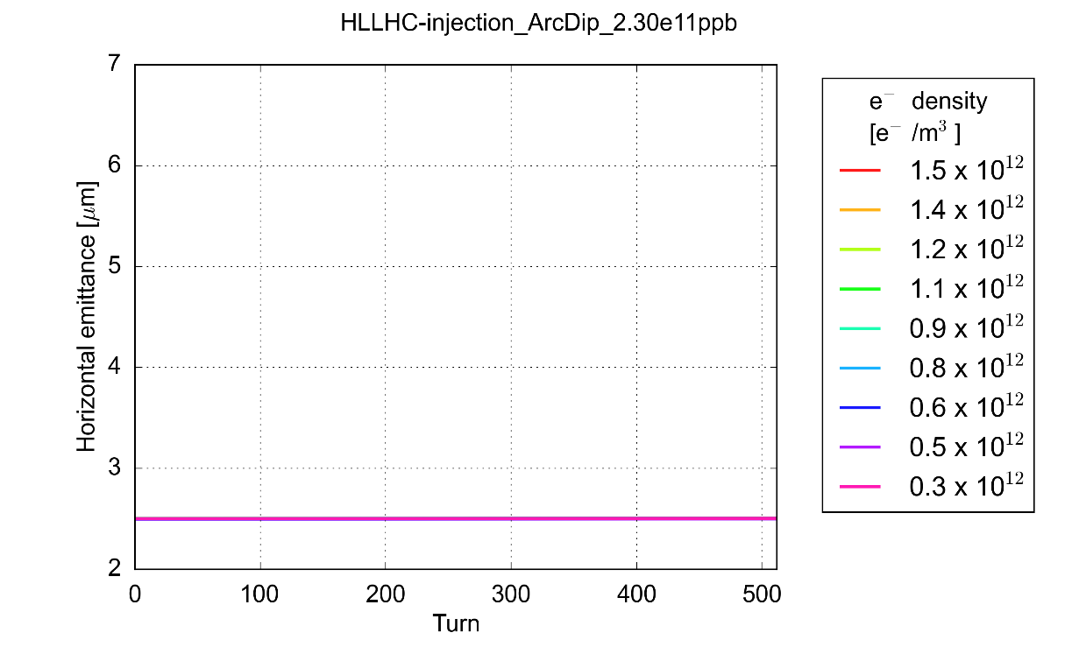
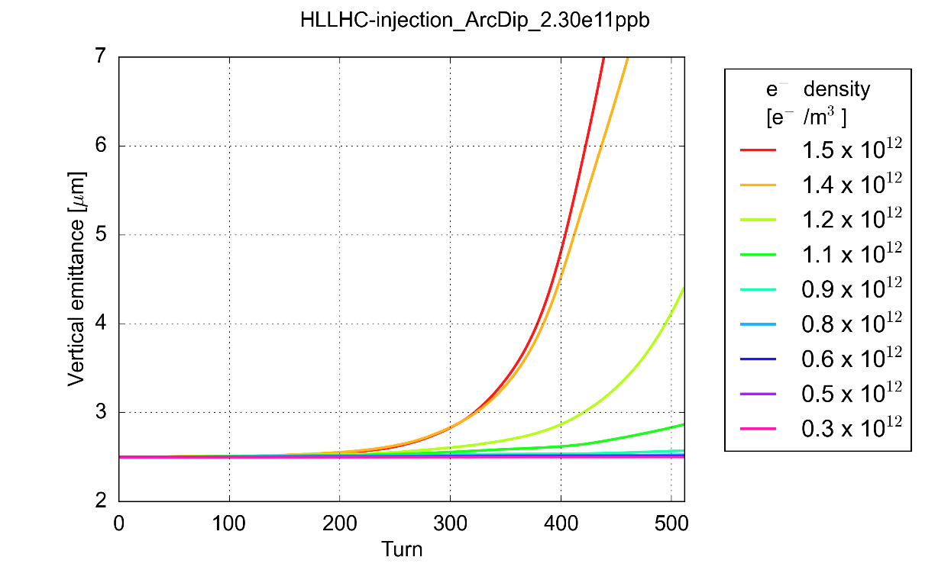
e-cloud instability thresholds: Arc Dipoles
Arc dipoles (~65% of the machine)
N = 2.3 x 10¹¹ p/b
Instability observed only in the vertical plane, as the dipole magnetic field freezes the electron motion in the horizontal plane (note that, unlike HEADTAIL, electrons are tracked also in the horizontal plane)
Dependence of the instability threshold on bunch intensity is quite weak:
 | 1.3 x 10 ¹¹ ppb | 1.8 x 10 ¹¹ ppb | 2.3 x 10 ¹¹ ppb
450 GeV | 1.2 x 10 ¹² e⁻/m³ | 1 x 10 ¹² e⁻/m³ | 1 x 10 ¹² e⁻/m³

Slide 11
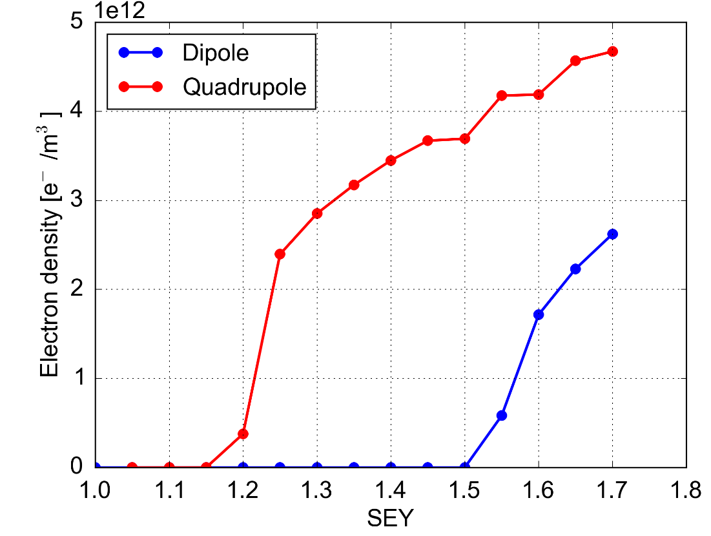
e-cloud instability thresholds: Arc Dipoles
Arc dipoles (~65% of the machine)
 | 1.3 x 10 ¹¹ ppb | 1.8 x 10 ¹¹ ppb | 2.3 x 10 ¹¹ ppb
450 GeV | 1.2 x 10 ¹² e⁻/m³ | 1 x 10 ¹² e⁻/m³ | 1 x 10 ¹² e⁻/m³
Comparing against buildup simulation results:
SEY > 1.5 needed for the ecloud in the dipoles alone to drive an instability
PyECLOUD buildup simulations – 2.3e11 ppb

Slide 12
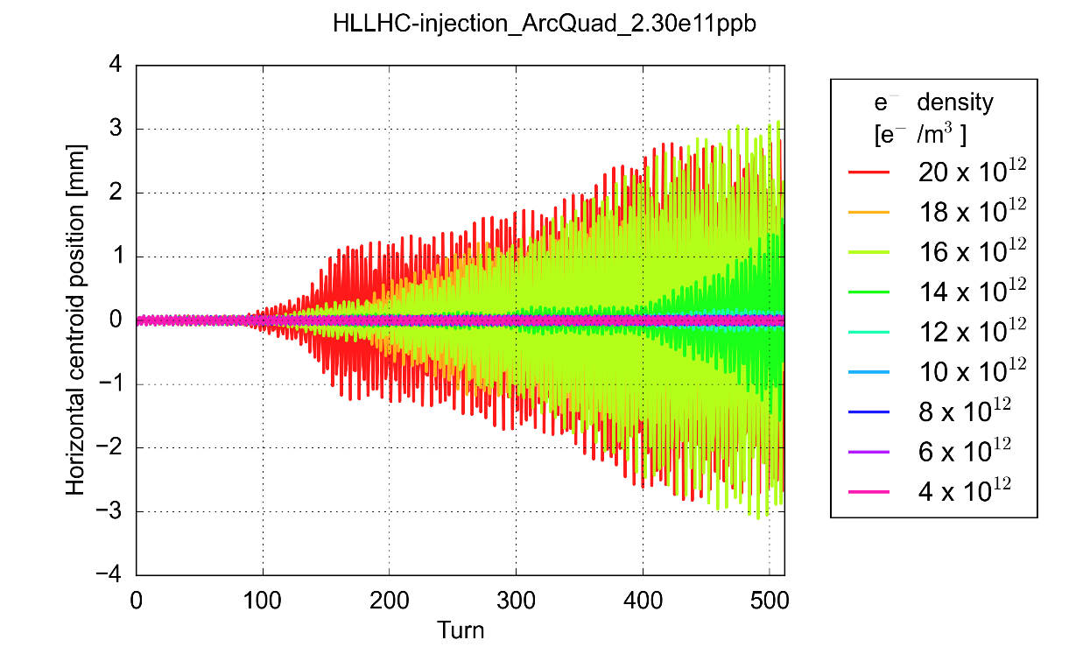
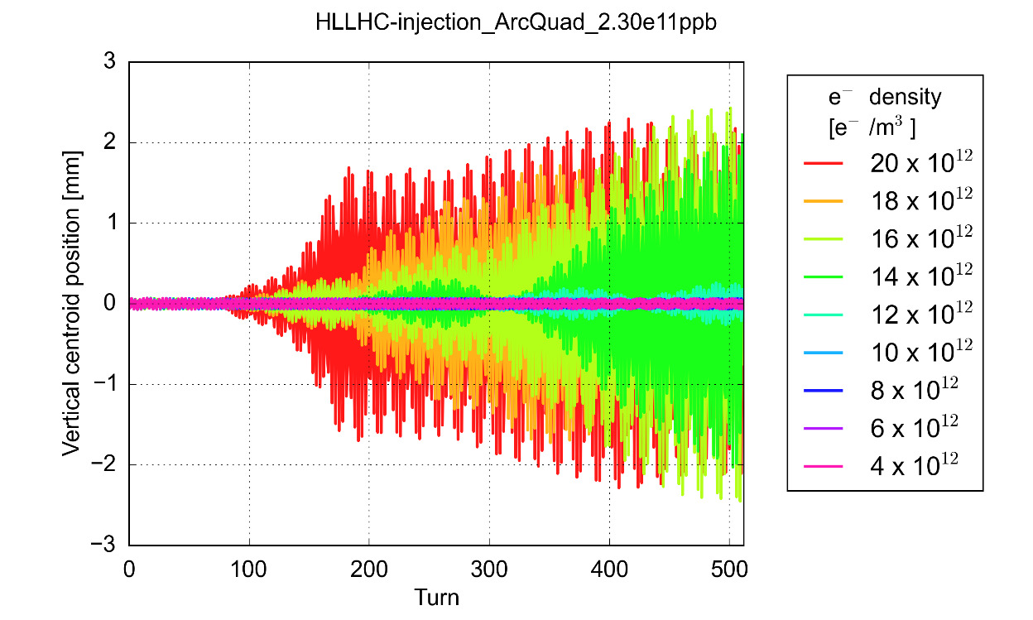
e-cloud instability thresholds: Arc Quadrupoles
Arc qudrupoles (~5% of the machine)
 | 1.3 x 10 ¹¹ ppb | 1.8 x 10 ¹¹ ppb | 2.3 x 10 ¹¹ ppb
450 GeV | 9 x 10 ¹² e⁻/m³ | 9 x 10 ¹² e⁻/m³ | 10 x 10 ¹² e⁻/m³
Dependence on bunch intensity is quite weak
Instability observed in both planes, consistently with the symmetry of the e-cloud dynamics in the quadrupoles
N = 2.3 x 10¹¹ p/b

Slide 13
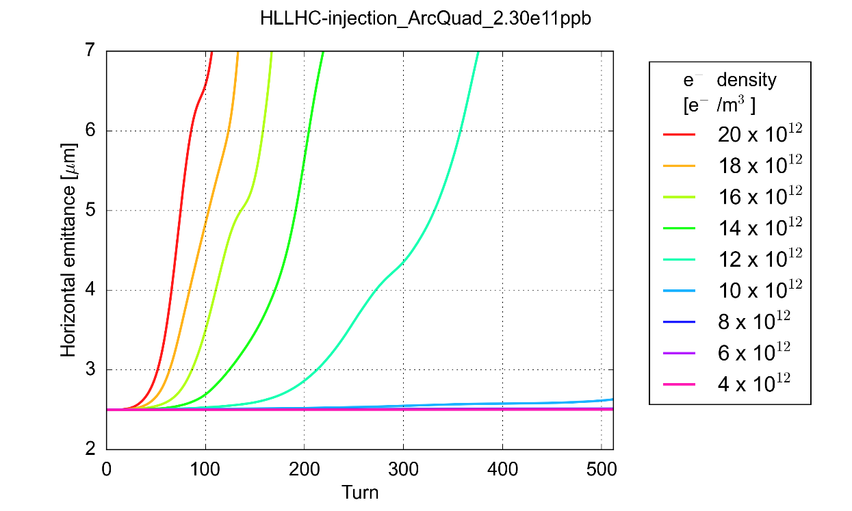
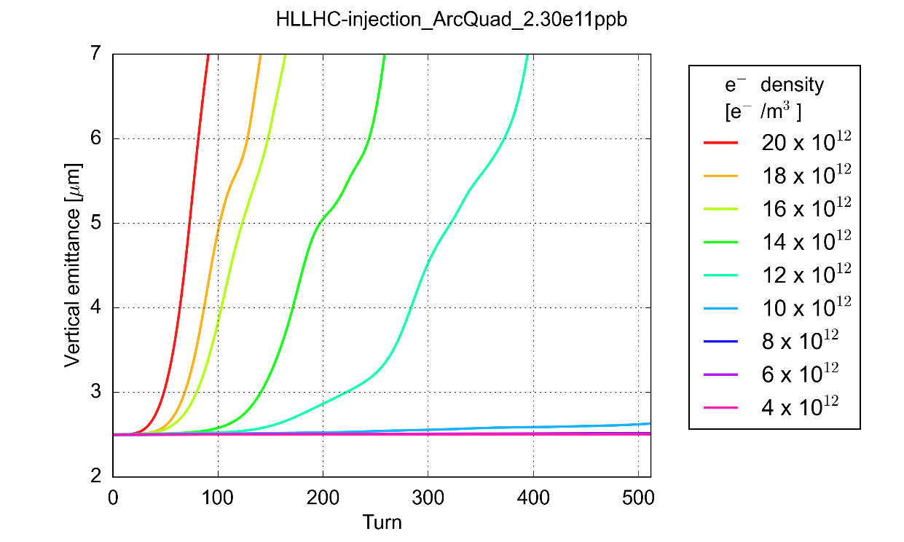
e-cloud instability thresholds: Arc Quadrupoles
Arc qudrupoles (~5% of the machine)
 | 1.3 x 10 ¹¹ ppb | 1.8 x 10 ¹¹ ppb | 2.3 x 10 ¹¹ ppb
450 GeV | 9 x 10 ¹² e⁻/m³ | 9 x 10 ¹² e⁻/m³ | 10 x 10 ¹² e⁻/m³
Dependence on bunch intensity is quite weak
Instability observed in both planes, consistently with the symmetry of the e-cloud dynamics in the quadrupoles
N = 2.3 x 10¹¹ p/b

Slide 14
e-cloud instability thresholds: Arc Quadrupoles
Arc qudrupoles(~5% of the machine)
 | 1.3 x 10 ¹¹ ppb | 1.8 x 10 ¹¹ ppb | 2.3 x 10 ¹¹ ppb
450 GeV | 9 x 10 ¹² e⁻/m³ | 9 x 10 ¹² e⁻/m³ | 10 x 10 ¹² e⁻/m³
Comparing against buildup simulation results:
For reasonable values of the SEY (i.e. after scrubbing) e-cloud in the quadrupoles alone too weak to drive an instability
PyECLOUD buildup simulations – 2.3e11 ppb

Slide 15
Instability thresholds at high energy: a first look
Simulations at 7 TeV are numerically more challenging due to the smaller beam size (need for finer grid) and stronger magnetic fields (need fro smaller time steps to resolve electron motion)
Arc quadrupoles (~5% of the machine)
 | 1.3 x 10 ¹¹ ppb | 1.8 x 10 ¹¹ ppb | 2.3 x 10 ¹¹ ppb
450 GeV | 9 x 10 ¹² e⁻/m³ | 9 x 10 ¹² e⁻/m³ | 10 x 10 ¹² e⁻/m³
7 TeV | 1.2 x 10 ¹⁴ e⁻/m³ | 1.1 x 10 ¹⁴ e⁻/m³ | 1.2 x 10 ¹⁴ e⁻/m³
Preliminary!!
Arc dipoles (~65% of the machine)
 | 1.3 x 10 ¹¹ ppb | 1.8 x 10 ¹¹ ppb | 2.3 x 10 ¹¹ ppb
450 GeV | 1.2 x 10 ¹² e⁻/m³ | 1 x 10 ¹² e⁻/m³ | 1 x 10 ¹² e⁻/m³
7 TeV | 8 x 10 ¹² e⁻/m³ | 8 x 10 ¹² e⁻/m³ | 9 x 10 ¹² e⁻/m³
Preliminary!!
The threshold e⁻ density for transverse instability increases by one order of magnitude going to 7 TeV → effect of increased beam rigidity

Slide 16
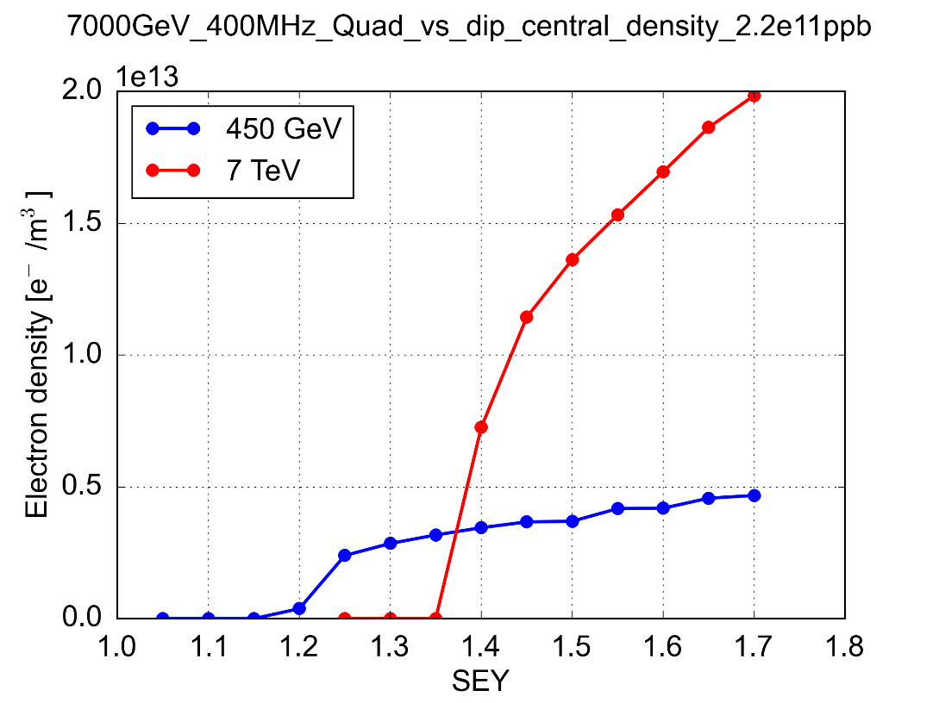
Instability thresholds at high energy: a first look
The threshold e⁻ density for transverse instability increases by one order of magnitude going to 7 TeV → effect of increased beam rigidity
Arc quadrupoles (~5% of the machine)
 | 1.3 x 10 ¹¹ ppb | 1.8 x 10 ¹¹ ppb | 2.3 x 10 ¹¹ ppb
450 GeV | 9 x 10 ¹² e⁻/m³ | 9 x 10 ¹² e⁻/m³ | 10 x 10 ¹² e⁻/m³
7 TeV | 1.2 x 10 ¹⁴ e⁻/m³ | 1.1 x 10 ¹⁴ e⁻/m³ | 1.2 x 10 ¹⁴ e⁻/m³
Preliminary!!
PyECLOUD buildup simulations
Quadrupoles: increase in energy has an important impact also on the e-cloud buildup due to the gradient increase
→ Densities still well below instability threshold for reasonable values of SEY

Slide 17

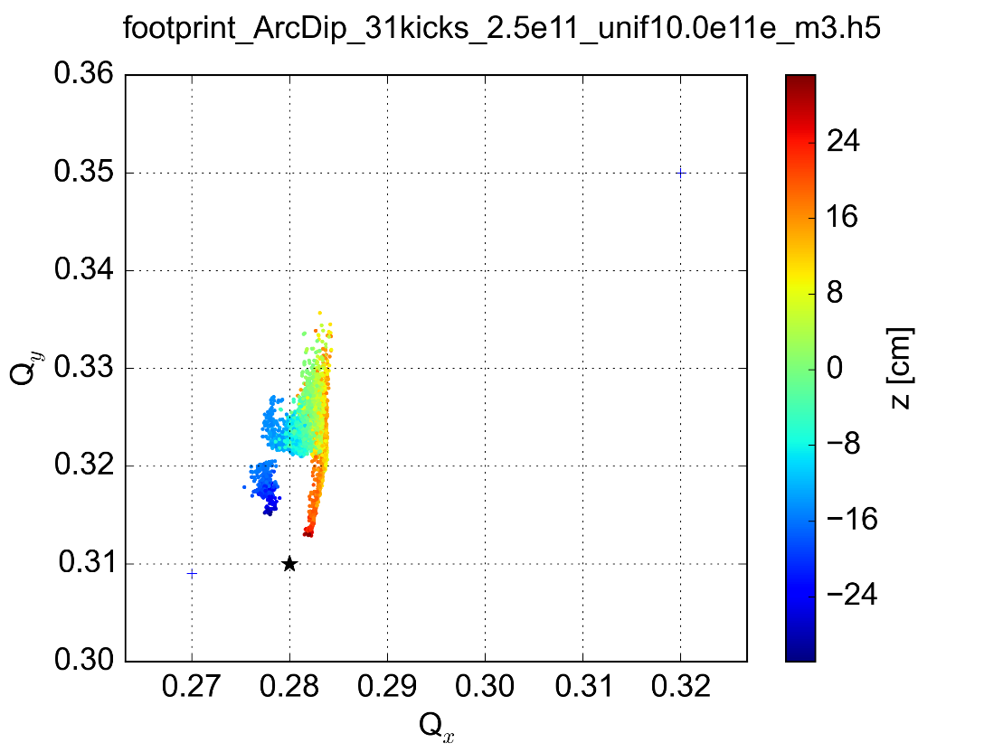
Tune footprint due to e-cloud in the Arc Dipoles
Even below the instability threshold e-cloud is exerting forces on beam particles
→ Tune footprint
Instantaneous footprint obtained with frozen longitudinal motion and “recorded” e⁻ pinch
Electrons are free to move only in the vertical plane: footprint is asymmetric

Slide 18
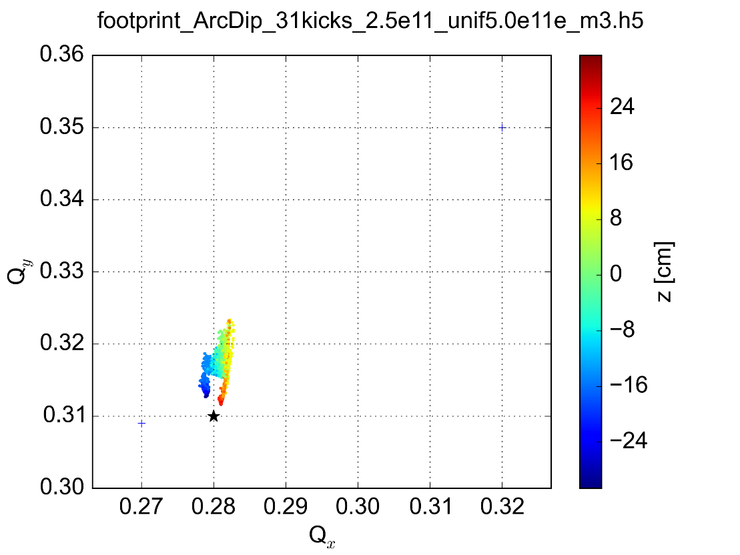
Tune footprint due to e-cloud in the Arc Dipoles
Even below the instability threshold e-cloud is exerting forces on beam particles
→ Tune footprint
Electrons are free to move only in the vertical plane: footprint is asymmetric

Slide 19
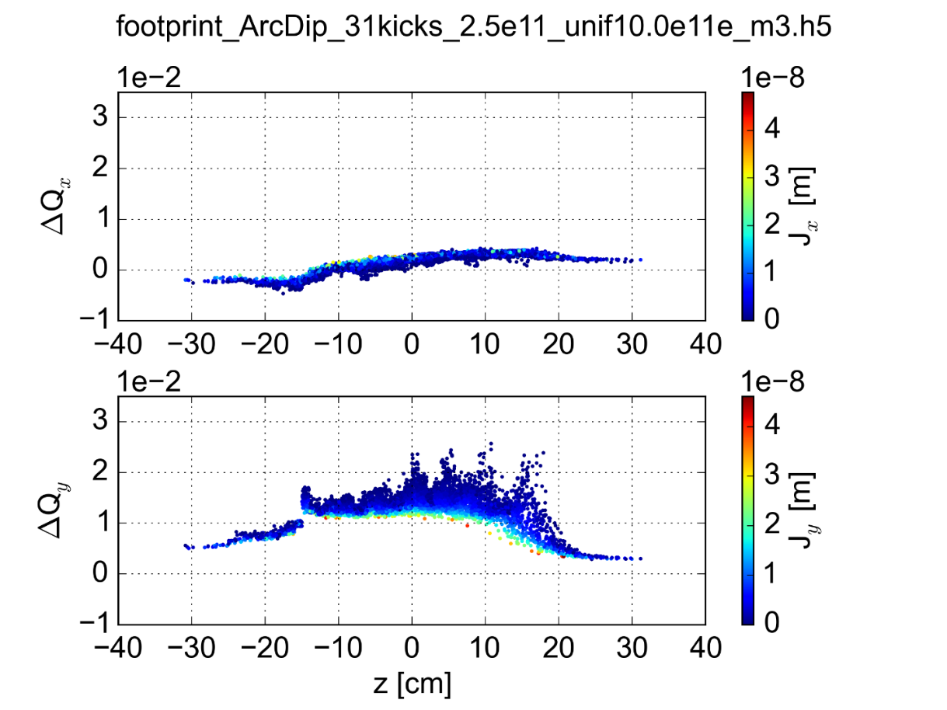
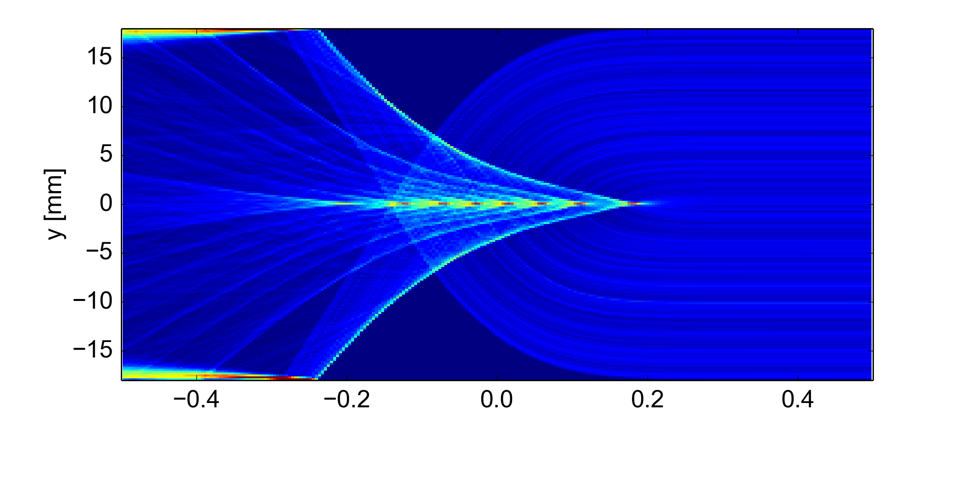
Tune footprint due to e-cloud in the Arc Dipoles
Vertical plane: tune spread dominated by e-cloud density inside the bunch → Positive tune shift
e⁻ pinch and density oscillations clearly visible on tunes along the bunch
z [m]

Slide 20
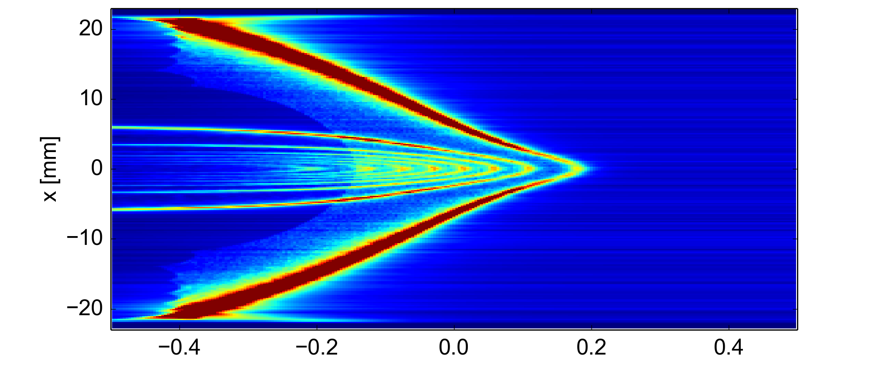
Tune footprint due to e-cloud in the Arc Dipoles
Horizontal plane: tune spread smaller than in vertical
Defocusing effect at bunch tail due to large density on bunch side

Slide 21
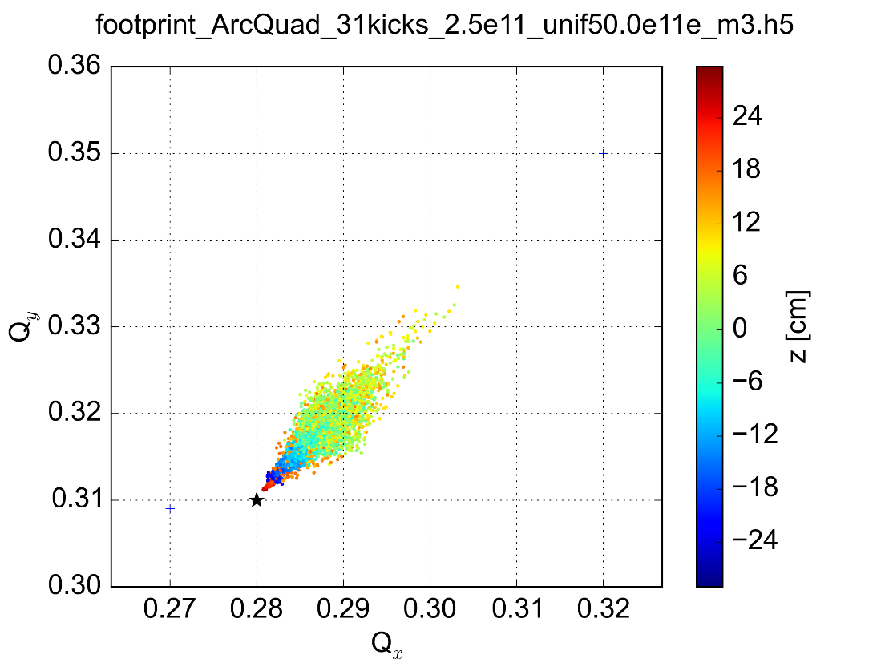
Tune footprint due to e-cloud in the Arc Quadrupoles
Even below the instability threshold e-cloud is exerting forces on beam particles
→ Tune footprint
Symmetry of the B field map translates into a symmetric footprint

Slide 22
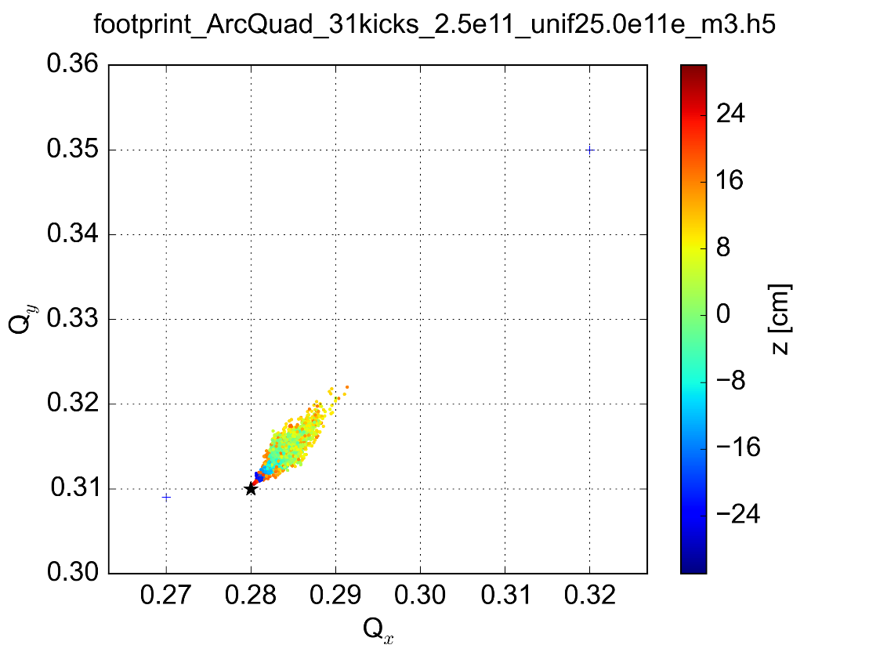
Tune footprint due to e-cloud in the Arc Quadrupoles
Even below the instability threshold e-cloud is exerting forces on beam particles
→ Tune footprint
Symmetry of the B field map translates into a symmetric footprint

Slide 23
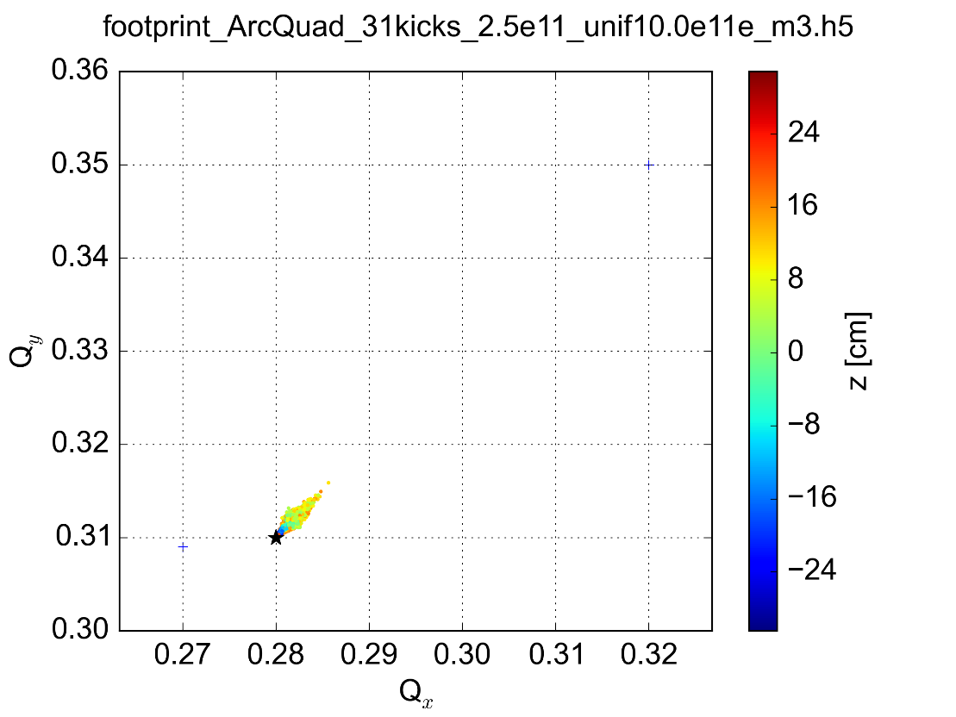
Tune footprint due to e-cloud in the Arc Quadrupoles
Even below the instability threshold e-cloud is exerting forces on beam particles
→ Tune footprint
Symmetry of the B field map translates into a symmetric footprint

Slide 24
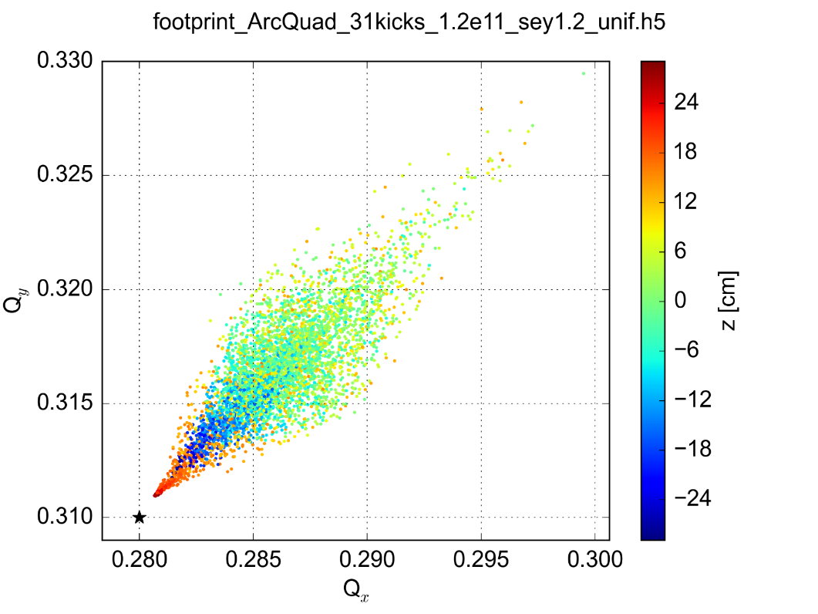
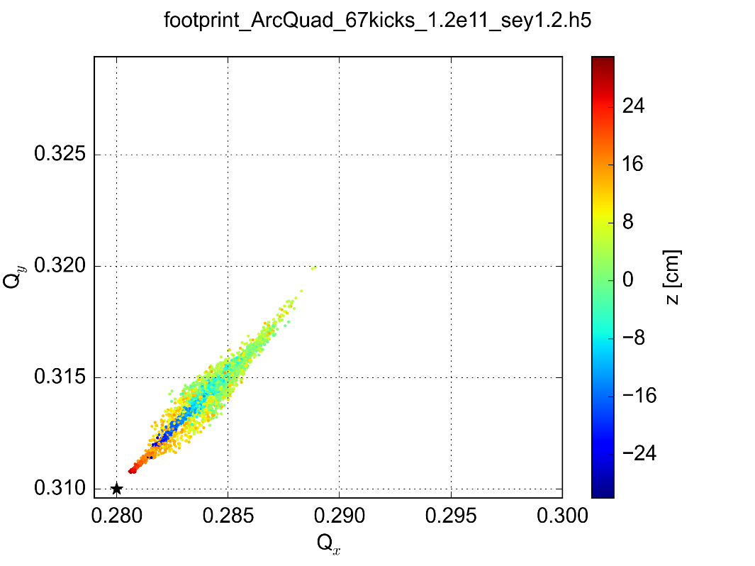
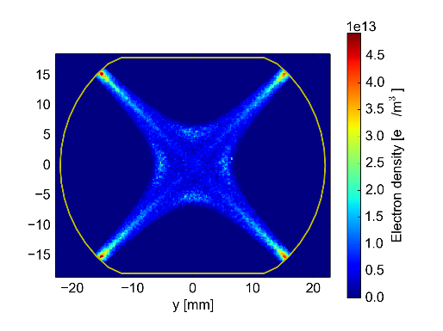
Arc Quadrupoles: realistic e⁻ distribution
First test performed with self consistent distribution from buildup simulation
Significant impact on the footprint!
Tune footprint
(uniform initial distribution)
Tune footprint
(initial distribution from buildup sim.)
Simulations for nominal bunch intensity

Slide 25
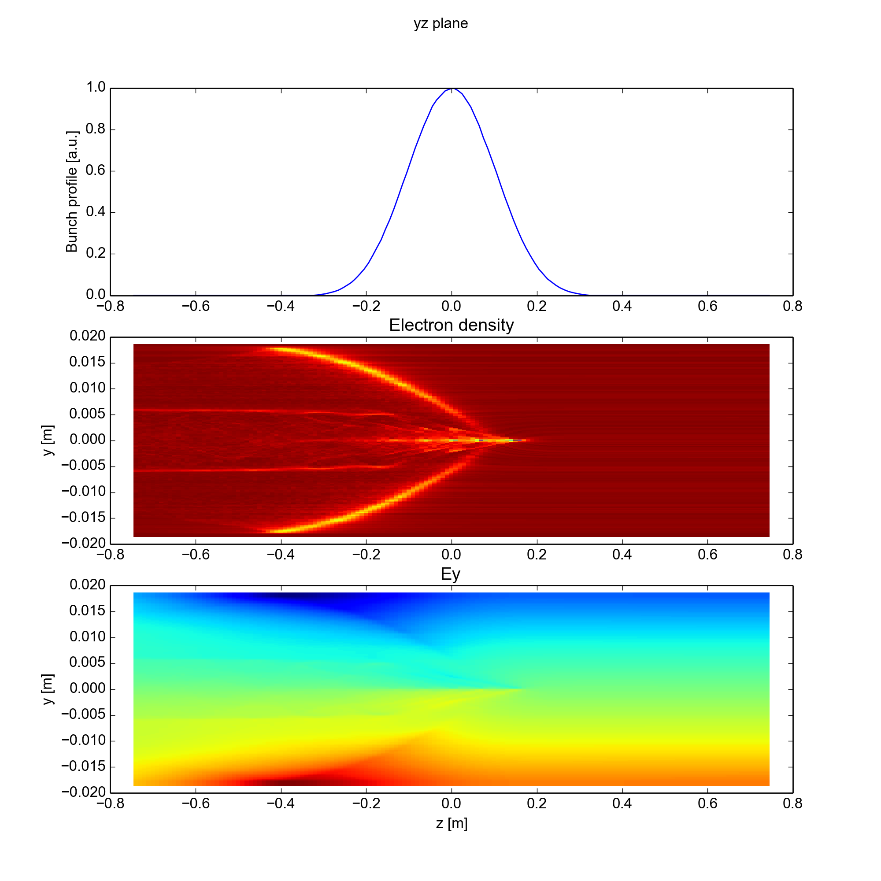
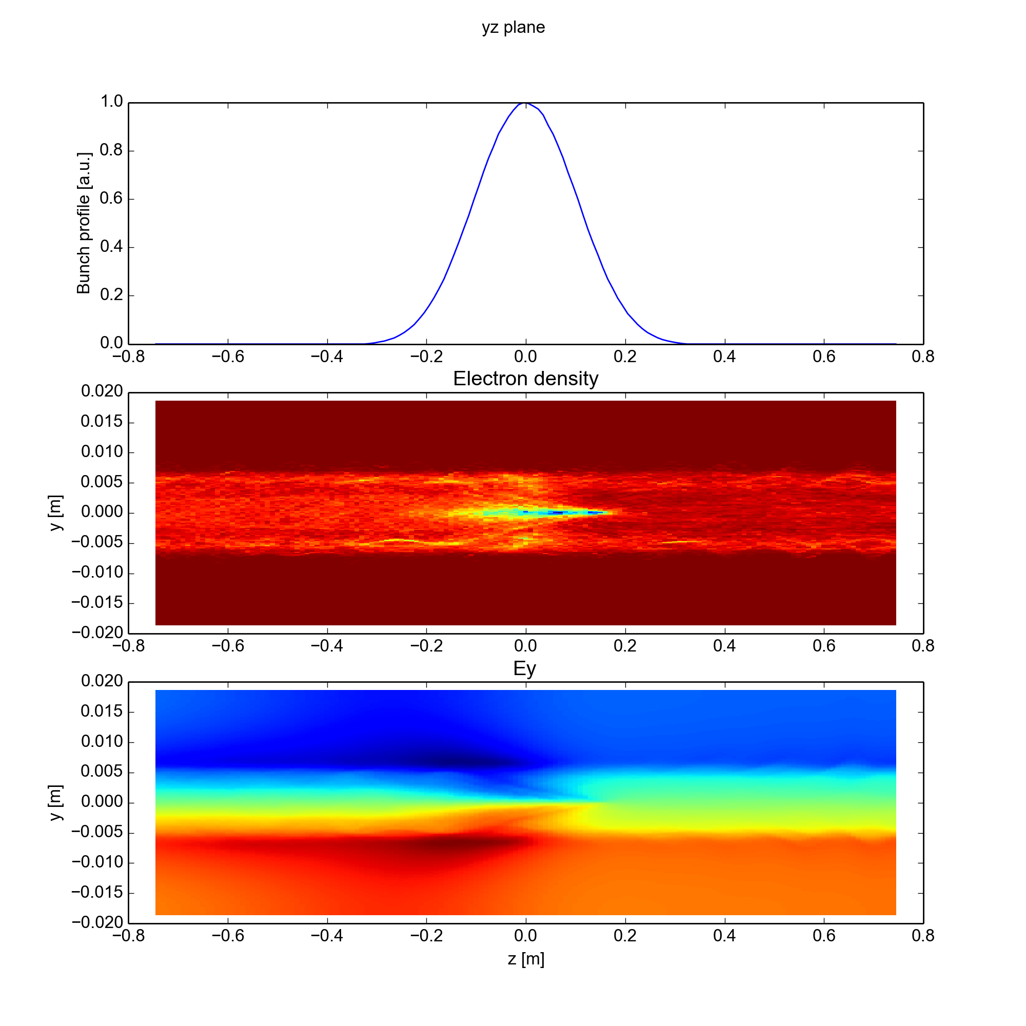
Arc Quadrupoles: realistic e⁻ distribution
First test performed with self consistent distribution from buildup simulation
Significant impact on the footprint!
Electrons trapped along the magnetic → pinch is attenuated
Uniform initial distribution
y [m]
z [m]
Initial distribution from buildup simulation
y [m]
z [m]

Slide 26
Summary and conclusions
For the main magnets in arcs we will have to rely on beam induced scrubbing to mitigate e-cloud effects also in the HL-LHC era
Full suppression should be possible for the arc dipoles but seems unlikely for the quadrupoles
Heat loads should be within the cryo cooling capacity but impact on beam quality/stability needs to be assessed
Important development work (PyECLOUD-PyHEADTAIL simulation setup) carried out in the latest year to allow the simulation of this kind of scenario → test & validation of the new tool done
First simulation campaign for HL-LHC arc main magnets:
After SEY reduction through beam induced scrubbing (SEY < 1.3) e-cloud should not drive the beam unstable…
… but still important forces on the beam → tune spread
First simulations at high energy show that at 7 TeV instability threshold density is 10 times larger than at 450 GeV (increased beam rigidity)
First tests performed with e-cloud distribution from buildup simulation show significant change with respect to the corresponding cases with uniform initial distribution (especially for the quadrupoles)
→ Instability threshold and footprint to be updated with self-consistent distributions

Slide 27
Thanks for your attention!

Slide 28
Parameter | Value @450 GeV | Value @7 TeV
N (p/b) | 1.3 – 2.3 x 10¹¹ | 1.3 – 2.3 x 10¹¹
ε_{x,y} (μm) | 2.5 | 2.5
σ_{z} (m) | 0.1 | 0. 075
B (T, T/m) | 0.53, 12 | 8.2, 187
V_{400MHz} | 8 MV | 16 MV
N_{el} (e⁻/m³) | 0.3 – 20 x 10¹² | 0.3 – 20 x 10¹²
N_{segments} | 79 | 31
N_{MP} (e⁻) | 10⁵ | 10⁵
N_{MP} (p) | 3 x 10⁵ | 3 x 10⁵
N_{slices} (-2σ_{z}, 2σ_{z}) | 64 | 64
Q_{x}, Q_{y} | 62.28 | 60.31
<β_{x}>, <β_{y}> | 92.7 | 93.2
Sync period | ~200 turns | ~500 turns

Slide 29
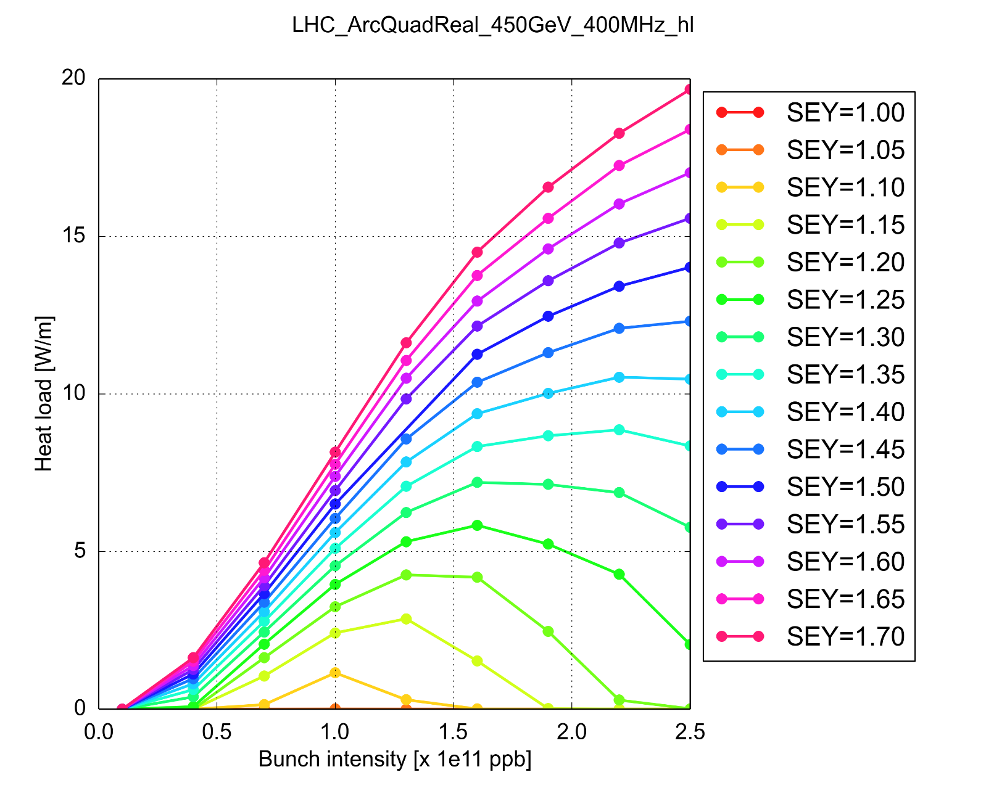

Slide 30
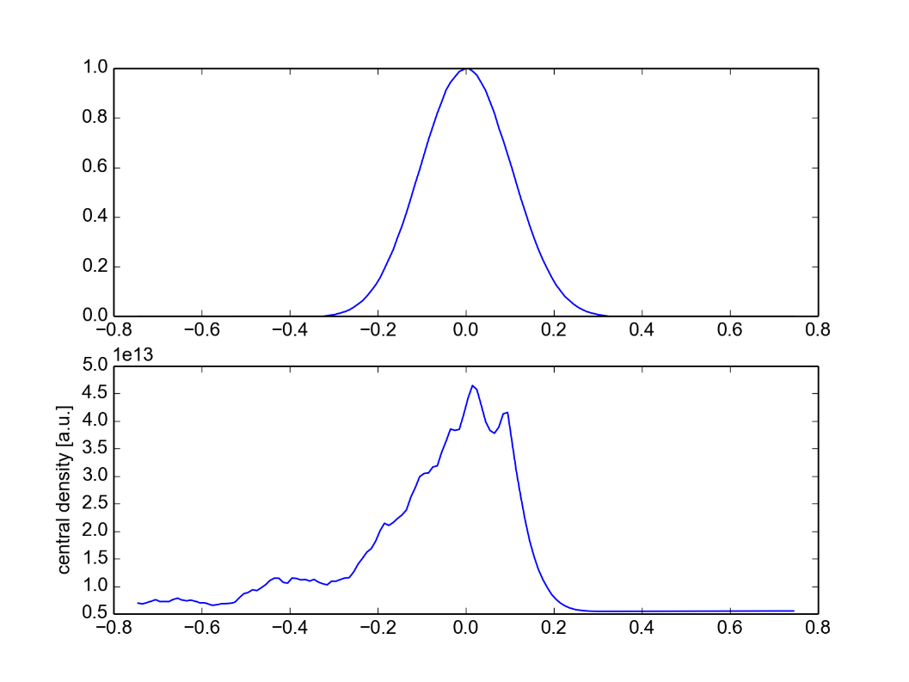
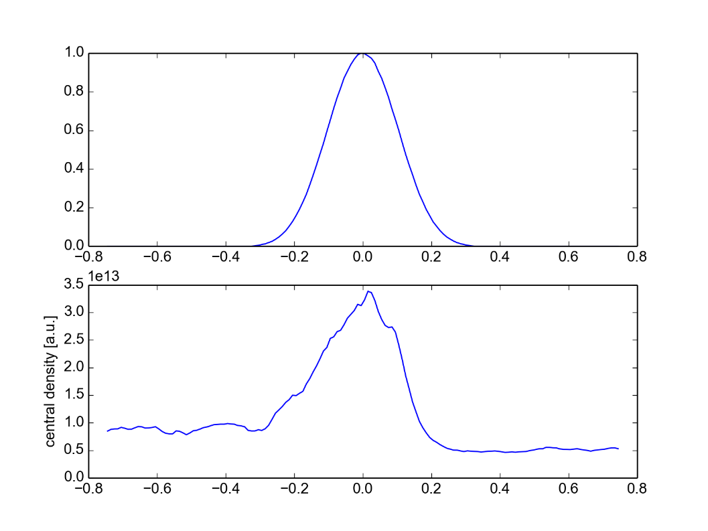
Uniform
From buildup

